Slide 1


I-K-MEANS -+ : an iterative clustering algorithm based on an enhanced version of the k-means
Ismkahn (2018)
Henry Morgan

Slide 2
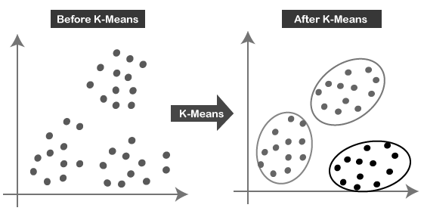

K-means clustering
Create K clusters where each observation is in the cluster with the nearest centroid/mean
Take an initial set of K centroids/means
Assign each observation to the closest centroid/mean
Re-compute centroid/mean
Repeat until convergence
Objective: minimize SSEDM over all clusters
(sum of squared Euclidean distances to the mean)
Image: https://www.kaggle.com/heeraldedhia/kmeans-clustering-for-customer-data

Slide 3
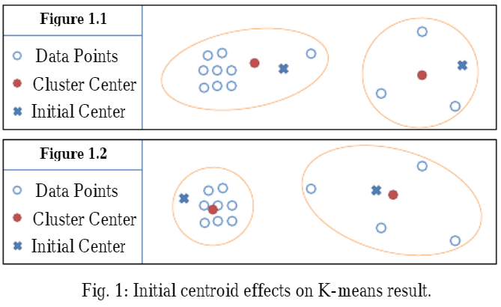
K-means clustering: the issue
The discovered clusters are highly dependent on the initially selected centroids
Solution: cluster initialization methods
Select optimal K initial points
Maxmin
Minmax
K-means ++
Global K-means
As K increases, accuracy still decreases
https://www.researchgate.net/publication/256090350_DIMK-means_Distance-based_Initialization_Method_for_K-means_Clustering_Algorithm#pf4

Slide 4
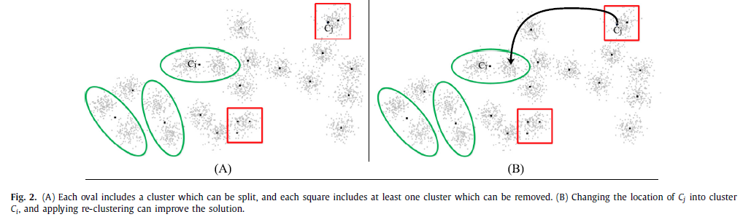
I K-means -/+ clustering
Algorithm developed by Hassan Ismkahn of the University of Bonab which targets the K-means initialization issue
Paper targets iteration; algorithm at its simplest:
Removes one cluster
Splits another cluster into two
Re-clusters
Iterative K-Means - +
<figure>

Slide 5
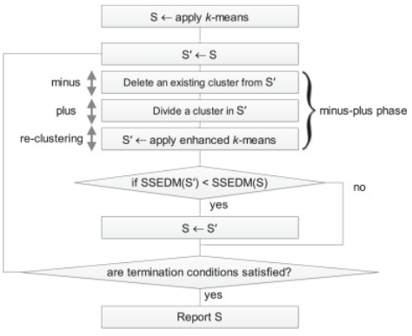
I K-means -/+: the trick
The issue with I K means - +: computational time required for iterations
Methods added to:
Identify best cluster for removal
Identify best cluster for splitting
Accelerate re-clustering
<figure>

Slide 6

I K-means -/+: cluster identification
Before division, estimation of the best cluster to remove and to split allows avoidance of trial-and-error procedures
Metric: sum of squared Euclidean distances to the mean/center (per group), SSEDM
For a cluster S_{i}:
<figure>

Slide 7
I K-means -/+: cluster identification
Approximate Cost(S_{j}), the cost of removing the cluster S_{j}, as the increase in the total SSEDM over all clusters, SSEDM(S), after S_{j} is removed:
Value removed from SSEDM(S) is simply SSEDM(S_{j}) before removal of S_{j}
Value added to SSEDM(S) can be approximated with the sum of the squared distance of each point in S_{j} from the second nearest center (CC_{p} below), which can be found at the same time as initial K-Means center assignment
<figure>

Slide 8

I K-means -/+: cluster identification
Approximate Gain(S_{i}), the gain from splitting the cluster S_{i}, as the decrease in the total SSEDM(S’) over all clusters, after S_{i} is split in two:
Value removed from SSEDM(S’) is simply SSEDM(S_{i}) before removal of S_{i}
Value added to SSEDM(S’) is SSEDM(S’_{i}) + SSEDM(S’_{j}), the SSEDM of the two new clusters
We do not know this before splitting and re-clustering
Distance approximation with ½ the current average distance of data in S_{i} from C_{i} under the assumption that the amount of data in S’_{I} & S’_{j} is |S_{i}|/2
<figure>

Slide 9
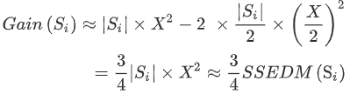
I K-means -/+: cluster identification
Value added to SSEDM(S’) is SSEDM(S’_{i}) + SSEDM(S’_{j}), the SSEDM of the two new clusters
Further approximating SSEDM(S_{i}) with
We can reach:
i.e. the gain from splitting a cluster can be approximated with ¾ of the SSEDM of that cluster pre-split
<figure>

Slide 10
I K-means -/+: cluster identification
Adjacency: cluster S_{k} with center C_{k} is adjacent to S_{i} with C_{i} iff there is P in S_{i} s.t. the second nearest center of P is C_{k} (note: not reciprocal)
Strong Adjacency: cluster S_{k} is strongly adjacent to S_{i} iff S_{k} is adjacent to S_{i} and S_{i} is adjacent to S_{k}
<figure>

Slide 11
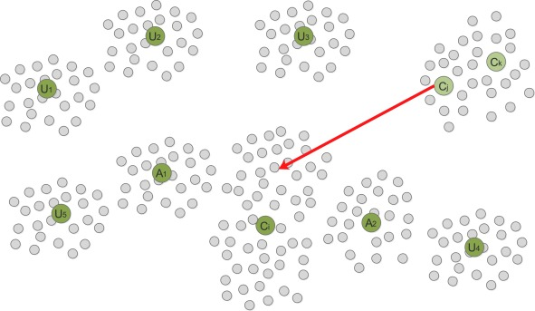
I K-means -/+: cluster identification
Heuristic 1: A pair of clusters, S_{i} and S_{j} can be considered for the minus-plus phase, S_{i} for dividing, and S_{j} for removing, if Gain(S_{i}) > Cost(S_{j})
Heuristic 2: If a cluster is produced by dividing another cluster in the current minus-plus phase, it and its strong adjacent clusters cannot be removed in the next iterations
Heuristic 3: If a cluster is removed in the current minus-plus phase, its strong adjacent clusters cannot be divided in the next iterations
<figure>

Slide 12
I K-means -/+: re-clustering
Necessary to re-apply K-Means following cluster removal and splitting
Significant cost in computation time
Is there a better algorithm?
<figure>

Slide 13
I K-means -/+: re-clustering
Necessary to re-apply K-Means following cluster removal and splitting
Significant cost in computation time
Is there a better algorithm?
Topical K-Means (T-K-means):
After the -/+ phase, only a part of the initial solution has been changed
Global re-clustering is unnecessary
Algorithm could only consider points affected by the prior +/- changes
Definition: in solution S, point P is an affected point of center C_{i} iff the first or second nearest center of P is C_{i}
<figure>

Slide 14
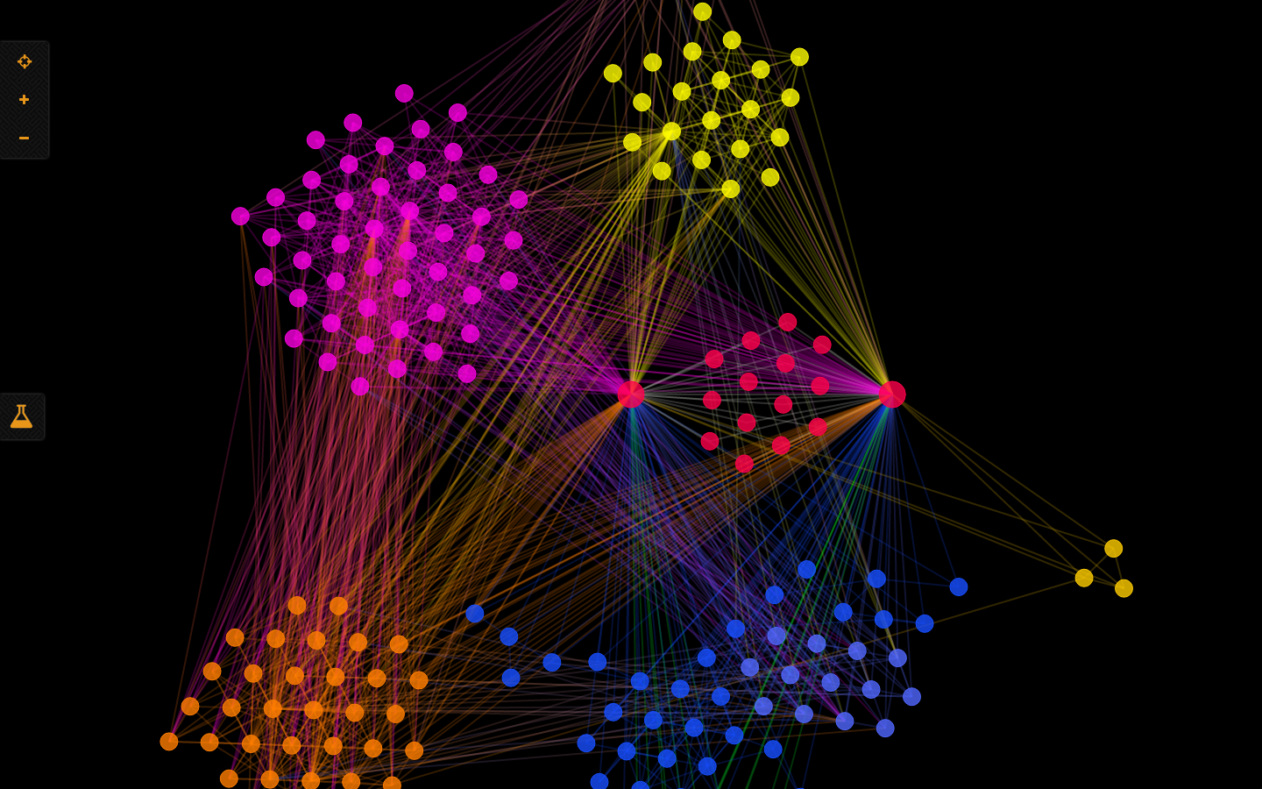
I K-means -/+: T-K-means
As applied to a set where the center C_{J} of cluster S_{j} is changed to be a random point in S_{i} which has center C_{i} (i.e. S_{j} has been deleted and S_{i} has been split)
Phase 1: initialization
Define AC (active centers) as a list of centers, holding only C_{i} and C_{j}
Define AC-Adjacent as the adjacent centers of C_{j} before removal
Define AP (affected points) as the affected points of C_{j} before removal
Phase 2: identification
If AC is empty, go to end
Add all adjacent centers of centers held in AC to AC-Adjacent
Define Potential-AC as an empty list
Add all affected points of centers in AC to AP
Image: https://towardsai.net/p/machine-learning/k-means-simplified

Slide 15
I K-means -/+: T-K-means
Phase 3: updating
For each point P in AP:
Update the first and second closest centers of P, considering as candidates centers held in AC and AC-Adjacent
If P’s closest center changes from C_{x} to C_{y}, add C_{x} and C_{y} to Potential-AC
Update all centers (re-calculate centroid of clusters)
Define AC as Potential-AC
If AC is not empty, return to Phase 2, else end
The algorithm is run until no affected point changes its closest center
Image: https://towardsai.net/p/machine-learning/k-means-simplified

Slide 16
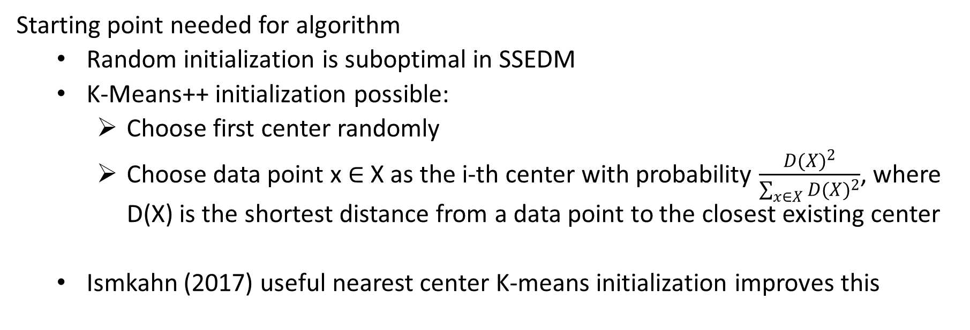
I K-means -/+: initialization
Starting point needed for algorithm
Random initialization is suboptimal in SSEDM
K-Means++ initialization possible:
Choose first center randomly
Choose data point x $∈$ X as the i-th center with probability $\frac{{D(X)}^{2}}{\sum_{x∈X}{{D(X)}^{2}}}$, where D(X) is the shortest distance from a data point to the closest existing center
Ismkahn (2017) useful nearest center K-means initialization improves this
<figure>

Slide 17
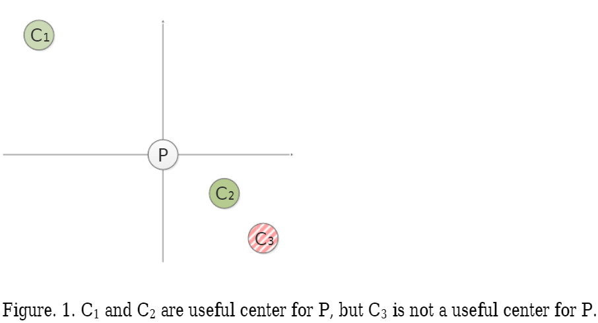
I K-means -/+: initialization
UNC-KM initialization:
Definition 1: a center C is useless for point P, if for a center C_{x}:
dis(P, C_{x}) < dis(P, C)
dis(C, C_{x}) < dis(P, C)
Definition 2: a center C is useful for point P if it is not useless
https://www.researchgate.net/publication/316859416_An_initialization_method_for_the_k-means_using_the_concept_of_useful_nearest_centers

Slide 18
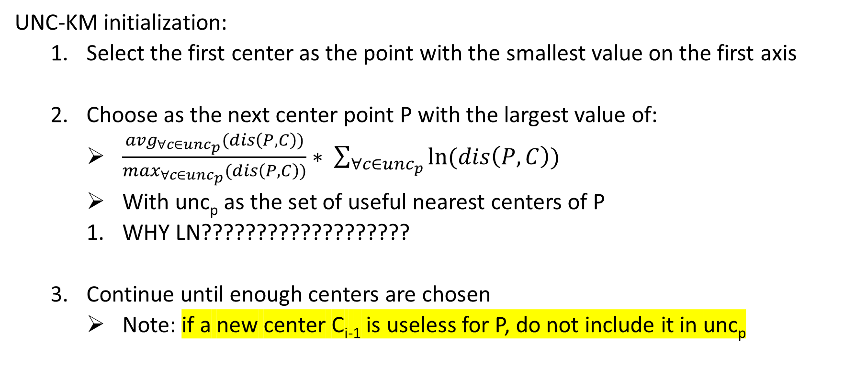
I K-means -/+: initialization
UNC-KM initialization:
Select the first center as the point with the smallest value on the first axis
Choose as the next center point P with the largest value of:
$\frac{{avg}_{∀c∈{unc}_{p}}(dis\left(P,C\right))}{\max_{∀c∈{unc}_{p}}(dis\left(P,C\right))}∗ \sum_{∀c∈{unc}_{p}}{ln⁡(dis\left(P,C\right))}$
With unc_{p} as the set of useful nearest centers of P
WHY LN???????????????????
Continue until enough centers are chosen
Note: if a new center C_{i-1} is useless for P, do not include it in unc_{p}
https://www.researchgate.net/publication/316859416_An_initialization_method_for_the_k-means_using_the_concept_of_useful_nearest_centers

Slide 19
I K-means -/+
All concepts and the T-K-means are then tied together to give us the I-K-means -/+
Apply the K-means (with initialization method XXXXX) to produce solution S with clusters S_{i} (1 <= i <= k)
Define the variable success as 0
Choose the cluster S_{i} with the largest estimated gain among clusters not marked as indivisible (if there is no such cluster, go to the end)
Check all clusters - if k/2 clusters have a gain larger than S_{i}, go to the end
This implies there are k/2 indivisible clusters with a larger SSEDM, meaning that dividing S_{i} cannot be reasonable
Choose a cluster S_{j} with the smallest estimated cost among clusters satisfying the following conditions (if none, go to the end)
<figure>

Slide 20
I K-means -/+
Choose a cluster S_{j} with the smallest estimated cost among clusters satisfying the following conditions (if none, go to the end)
S_{j} is not S_{i}
S_{j} is not marked as irremovable
S_{j} and S_{i} should not be marked as an unmatchable pair
Cost(S_{j}) < Gain(S_{i})
S_{i} is not an adjacent of S_{j} and vice versa (they are not strongly adjacent)
Either:
If there are k/2 irremovable clusters with cost smaller than S_{j} and which otherwise satisfy the above conditions, go to the end
If there are k/2 clusters that have cost smaller than S_{j}, then S_{i} cannot be paired with any other cluster so mark S_{i} as indivisible and return to step 3
<figure>

Slide 21
I K-means -/+
T-K-means:
Create a new solution variable S’ = S
In S’, set the coordinates of cluster S_{j}’s C_{j} to a random data point from S_{i}
Update S’ with the T-K-Means
If SSEDM(S’) > SSEDM(S), solution not improved -> mark S_{i} and S_{j} as unmatchable Else:
Mark S_{i} and S_{j} as irremovable
Mark previous strong adjacent clusters of S_{j} as indivisible
Set S to S’
Mark the new strong adjacent clusters of S_{i} and S_{j} as irremovable
Add 1 to the success variable
If success > k/2, finish the algorithm
<figure>

